Slide 1
Data Science Task
André Oliveira

Slide 2
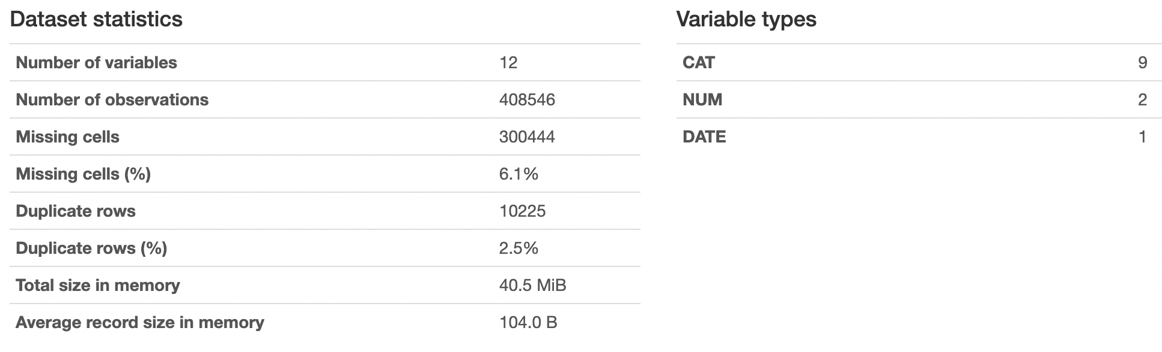
Task
Predict income and expenses for a holdout sample of ~10k users for the month of August, based on a training sample of ~10k users from February through July.
The data should be aggregated into incoming-outgoing flows, or transaction type/category level.

Slide 3
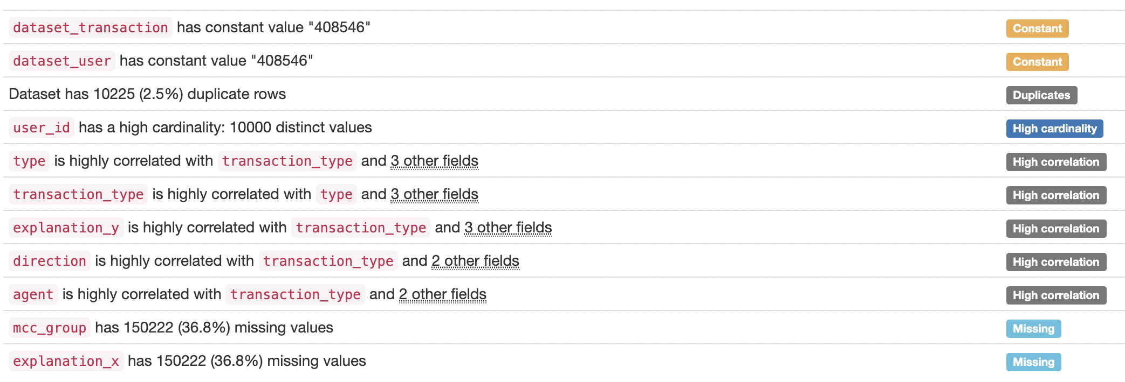
Exploratory Data Analysis
Main Findings

Slide 4
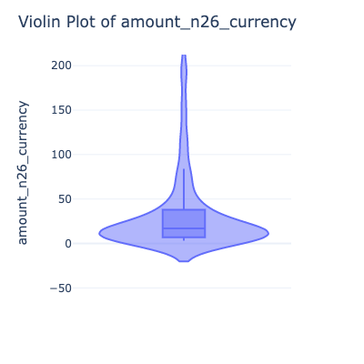
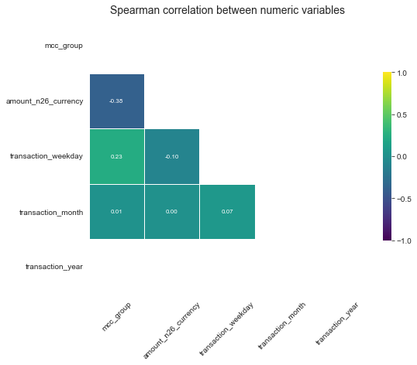
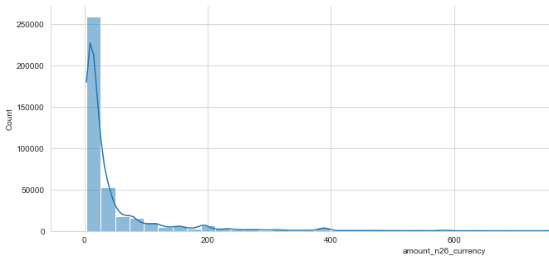
Exploratory Data Analysis
The feature amount_n26_currecy was used as target to predict the income.
It is the only numerical continuous variable in the dataset, being quite skewed to the left. In addition, it does not have high degree of linear association with any variable (correlation).

Slide 5
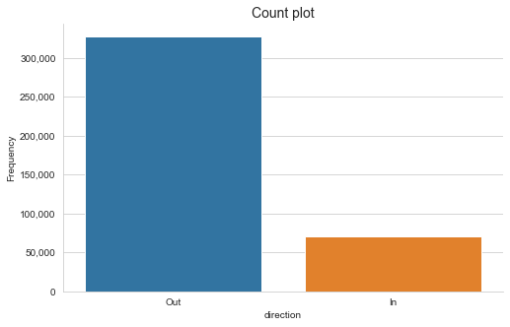
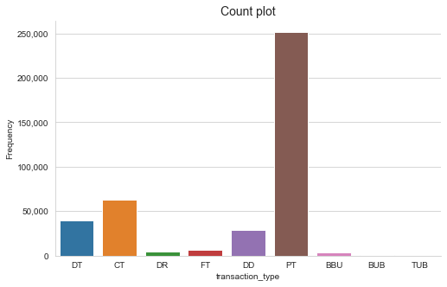
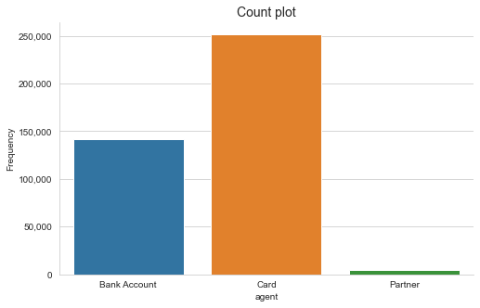
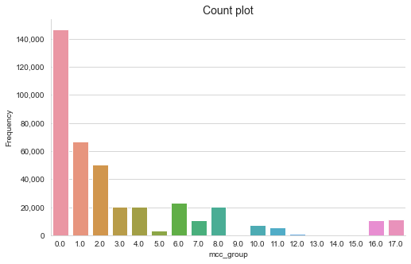
Exploratory Data Analysis
The categorical features of the dataset are quite imbalanced, showing that sampling techniques can potentially increase the model’s accuracy.
The missing values on the feature mcc_group were filled as 0, a new category.
In addition, the duplicate rows in the dataset were dropped.
The date feature was divided into year, month and week day.

Slide 6
Methodology
Approach
As the correlation analysis was not conclusive to identify a final set of relevant features to model in order to predict income, the approach was based on using the feature importance of a model.
The selected model was Gradient Boosting, as it performs well on unbalanced data. It is a type of machine learning model that creates an ensemble based on multiple weak leaners (decision trees). It starts by fitting an initial model to the data, then a second model is built that focuses on accurately predicting the cases where the first model performs poorly. The combination of these two models is expected to be better than either model alone. Then this process is repeated over and over again.
The hyperparameter tuning method was Bayesian Optimization, conscious of computing performance.
The dataset was split in 2 sets to avoid data leakage:
Train – used to train the model and perform the hyperparameter tuning with cross-validation.
Test – used to evaluate the model.

Slide 7
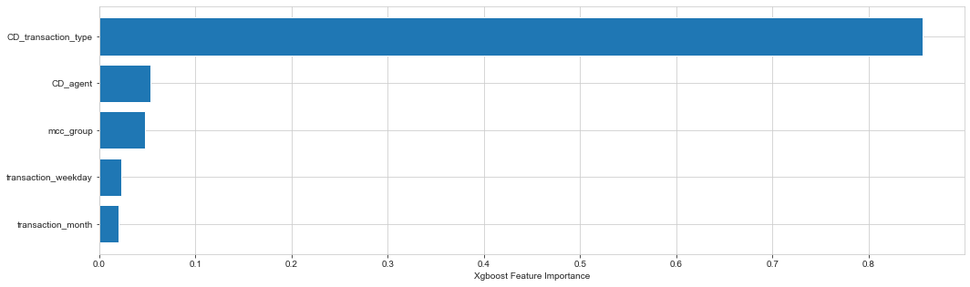
Methodology
The final list of features to include in the model was defined using the feature importance of the gradient boosting model that included all features of the dataset (except user_id) – the baseline model.
Afterwards a new model was prepared based on the feature importance output.
Evaluation Metrics
Mean Squared Error (MSE)
Mean Absolute Error (MAE)
Mean Absolute Percentage Error (MAPE)

Slide 8
Results
Model | MSE | MAE | MAPE
Baseline | 10370.2 | 48.5 | 2.3%
Filtered | 10374.6 | 48.5 | 2.3%
The baseline model includes all features from the dataset, while the filtered excludes the direction of the income flow.
The overall error results are very good, achieving less than 5% of MAPE. Furthermore, both models achieved similar error outputs.
Even though the filtered model has higher MSE and MAE, it was the selected model to predict the income in August. This is mainly due to the task requirement of not mixing the variables transaction type and income direction on the same model.
In order to improve the classifier, the class imbalance should be addressed, adopting for instance resampling techniques of under-sampling or over-sampling.
Deployment
There are a few steps to deploy the model in production:
Extract the code from jupyter notebook to python script.
Automate data collection process by connection to database/API.
Create an ETL job that runs the script automatically.
Create a set of dashboards to monitor output.

